Slide 1
sta302 final project
shimmy

Slide 2
R Markdown
This is an R Markdown document. Markdown is a simple formatting syntax for authoring HTML, PDF, and MS Word documents. For more details on using R Markdown see http://rmarkdown.rstudio.com.
When you click the Knit button a document will be generated that includes both content as well as the output of any embedded R code chunks within the document. You can embed an R code chunk like this:
setwd("C:/Users/shimm/OneDrive - University of Toronto/second_year/summer first semester/sta302/final project")
hypothesis, relationship between smoking and blood pressure.

Slide 3
setting up the data and the proper libraries
#libraries and given code rm(list = ls()) library(tidyverse)
## -- Attaching packages -------------------------------------------- tidyverse 1.3.0 --
## v ggplot2 3.3.2 v purrr 0.3.4 ## v tibble 3.0.2 v dplyr 1.0.0 ## v tidyr 1.1.1 v stringr 1.4.0 ## v readr 1.3.1 v forcats 0.5.0
## -- Conflicts ----------------------------------------------- tidyverse_conflicts() -- ## x dplyr::filter() masks stats::filter() ## x dplyr::lag() masks stats::lag()
library(NHANES)
## Warning: package 'NHANES' was built under R version 4.0.5
library(car)
## Loading required package: carData
## ## Attaching package: 'car'
## The following object is masked from 'package:dplyr': ## ## recode
## The following object is masked from 'package:purrr': ## ## some
library(olsrr)
## ## Attaching package: 'olsrr'
## The following object is masked from 'package:datasets': ## ## rivers
library(graphics) library(psych)
## ## Attaching package: 'psych'
## The following object is masked from 'package:car': ## ## logit
## The following objects are masked from 'package:ggplot2': ## ## %+%, alpha
library(glmnet)
## Loading required package: Matrix
## ## Attaching package: 'Matrix'
## The following objects are masked from 'package:tidyr': ## ## expand, pack, unpack
## Loaded glmnet 4.0-2
library(rms)
## Loading required package: Hmisc
## Loading required package: lattice
## Loading required package: survival
## Loading required package: Formula
## ## Attaching package: 'Hmisc'
## The following object is masked from 'package:psych': ## ## describe
## The following objects are masked from 'package:dplyr': ## ## src, summarize
## The following objects are masked from 'package:base': ## ## format.pval, units
## Loading required package: SparseM
## ## Attaching package: 'SparseM'
## The following object is masked from 'package:base': ## ## backsolve
## ## Attaching package: 'rms'
## The following objects are masked from 'package:car': ## ## Predict, vif
small.nhanes <- na.omit(NHANES[NHANES$SurveyYr=="2011_12" & NHANES$Age > 17,c(1,3,4,8:11,13,17,20,21,25,46,50,51,52,61)]) small.nhanes <- as.data.frame(small.nhanes %>% group_by(ID) %>% filter(row_number()==1) ) nrow(small.nhanes)
## [1] 743
## Checking whether there are any ID that was repeated. If not ## ## then length(unique(small.nhanes$ID)) and nrow(small.nhanes) are same ## length(unique(small.nhanes$ID))
## [1] 743
1
## [1] 1
set.seed(1005476995) train <- small.nhanes[sample(seq_len(nrow(small.nhanes)), size = 500),] nrow(train)
## [1] 500
length(which(small.nhanes$ID %in% train$ID))
## [1] 500
test <- small.nhanes[!small.nhanes$ID %in% train$ID,] nrow(test)
## [1] 243
train_minus_id <- train[,2:17] test_minus_id <- test[,2:17]

Slide 4
creating valuable functions
f_multi_minus_vif <- function(m){ h <- hatvalues(m) thresh_hold <- 2*(dim(model.matrix(m))[2])/nrow(m$model) w <- which(h > thresh_hold) print("leverage") print(w) d <- cooks.distance(m) cut <- which(d > qf(.5, df1 = ncol(m$model[, -c(1)]) + 1, df2 = nrow(m$model[, -c(1)])-ncol(m$model[, -c(1)]) - 1) ) print("cut_d") print(cut) dfits<- dffits(m) cut_fits <- which( abs(dfits) > 2*sqrt((ncol(m$model[, -c(1)]) + 1)/nrow(m$model[, -c(1)])) ) print("cut_fits") print(cut_fits) df_b <- dfbetas(m) cut_b <- which( abs(df_b[,1]) > 2/sqrt(nrow(m$model[, -c(1)])) ) print("cut_beta") print(cut_b) print("lev + cut_b") lev_cut_b <- intersect(w, cut_b) print(lev_cut_b) print("lev + cut_fits") lev_cut_fits<- intersect(w, cut_fits) print(lev_cut_fits) print(" lev + cut_d") w_cut <- intersect(w, cut) print(w_cut ) print("b + fits") b_cut_fits <- intersect(cut_b, cut_fits) print(b_cut_fits) print("d + b") d_b <-intersect(cut_b, cut) print(d_b) print("d + fits") d_fits <- intersect(cut, cut_fits) print(d_fits) print(" all outliers intersect") all_intersection <- intersect(intersect(cut, cut_fits), cut_b) print(all_intersection ) ls <- list(lev_cut_b, lev_cut_fits, w_cut, b_cut_fits, d_b, d_fits, all_intersection) print(psych::pairs.panels(m$model[, -c(1)], density = TRUE)) print(plot(m)) print(anova(m)) return(ls) } f_multi_diagnostic<- function(m){ ls <- f_multi_minus_vif(m) v <- car::vif(m) print("VIF") print(v) return(ls) }

Slide 5
setting up the model with all variables and getting the error
model.all <- lm(BPSysAve ~., data = train_minus_id) model.all.error <- mean((model.all$model$BPSysAve - model.all$fitted.values)^2) model.all.error
## [1] 207.816

Slide 6
variable selection
lasso method
variable selection
set.seed(1005476995) cv.out <- cv.glmnet(x = data.matrix(train_minus_id[, -which(names( train_minus_id) == "BPSysAve")]), y = train_minus_id$BPSysAve, standardize = T, alpha = 1) #plot(cv.out) best.lambda <- cv.out$lambda.1se best.lambda
## [1] 3.710926
co<-coef(cv.out, s = "lambda.1se") co
## 16 x 1 sparse Matrix of class "dgCMatrix" ## 1 ## (Intercept) 111.7508418 ## Gender . ## Age 0.2413249 ## Race3 . ## Education . ## MaritalStatus . ## HHIncome . ## Poverty . ## Weight . ## Height . ## BMI . ## Depressed . ## SleepHrsNight . ## SleepTrouble . ## PhysActive . ## SmokeNow .
#model.matrix #wanna see how the preidction performance is in the trainng set #choose use 10 for B, and find which is the best model. Lasso, Aic, BIC. There is no one answer. #important to do cross validation. # should only be used for accuract of final model thresh <- 0.00 # select variables # inds<-which(abs(co) > thresh ) variables<-row.names(co)[inds] sel.var.lasso<-variables[!(variables %in% '(Intercept)')] sel.var.lasso
## [1] "Age"
model.lasso <- lm(BPSysAve ~., data = train_minus_id %>% select(Age, BPSysAve)) plot(model.lasso)

Slide 7
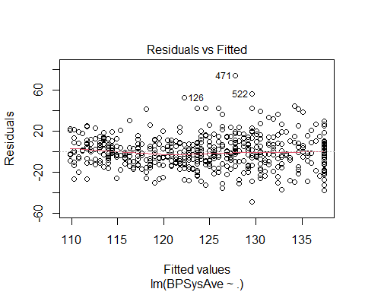

Slide 8
summary(model.lasso)
## ## Call: ## lm(formula = BPSysAve ~ ., data = train_minus_id %>% select(Age, ## BPSysAve)) ## ## Residuals: ## Min 1Q Median 3Q Max ## -48.590 -9.806 -0.763 8.666 74.249 ## ## Coefficients: ## Estimate Std. Error t value Pr(>|t|) ## (Intercept) 100.62666 2.19910 45.76 <2e-16 *** ## Age 0.45974 0.04096 11.22 <2e-16 *** ## --- ## Signif. codes: 0 '***' 0.001 '**' 0.01 '*' 0.05 '.' 0.1 ' ' 1 ## ## Residual standard error: 15.56 on 498 degrees of freedom ## Multiple R-squared: 0.2019, Adjusted R-squared: 0.2003 ## F-statistic: 126 on 1 and 498 DF, p-value: < 2.2e-16
outliers
hii <- hatvalues(model.lasso) leverage_point <- which(hii > 4/nrow(model.lasso$model)) cooks <- cooks.distance(model.lasso) outliers <- which(cooks > 4/(nrow(model.lasso$model)-2)) lasso.outliers <- intersect(outliers, leverage_point) ggplot(model.lasso$model[-lasso.outliers,],aes(y = BPSysAve, x = Age)) + geom_point() + geom_smooth(method='lm', formula= y~x)

Slide 9
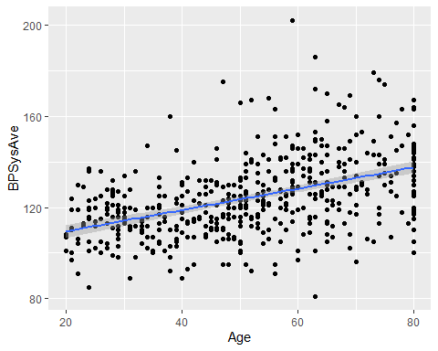

Slide 10
model.lasso.outliers <- lm(BPSysAve ~., data = train_minus_id[-lasso.outliers,] %>% select(Age, BPSysAve)) plot(model.lasso.outliers)

Slide 11
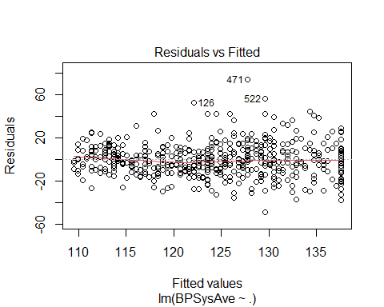

Slide 12
boxcox transformation
boxCox(model.lasso.outliers) # -.5

Slide 13
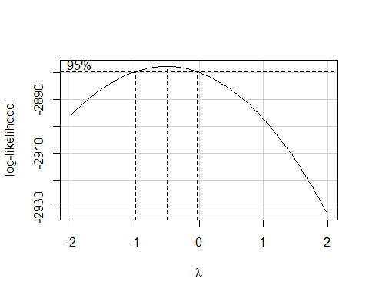

Slide 14
boxCox(lm(Age ~ 1, data = train_minus_id[-lasso.outliers,] %>% select(Age, BPSysAve))) # approx 1

Slide 15
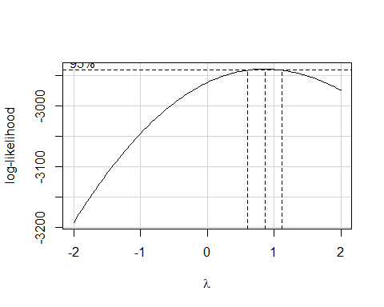

Slide 16
final model and calculations
model.lasso.boxcox <- lm((BPSysAve^(-.5) - 1)/(-.5) ~., data = train_minus_id[-lasso.outliers,] %>% select(Age, BPSysAve)) plot(model.lasso.boxcox)

Slide 17
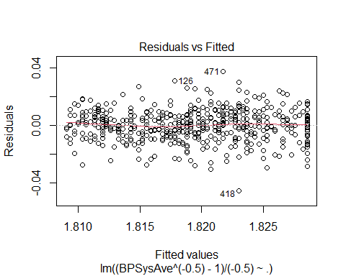

Slide 18
error.lasso <- mean((model.lasso.boxcox$model$`(BPSysAve^(-0.5) - 1)/(-0.5)` - model.lasso.boxcox$fitted.values)^2) error.lasso
## [1] 0.000118855
cross validation and test error
### Cross Validation and prediction performance of lasso based selection ### ols.lasso <- ols(`(BPSysAve^(-0.5) - 1)/(-0.5)` ~ ., data = model.lasso.boxcox$model, x=T, y=T, model = T) ## 10 fold cross validation ## lasso.cross <- calibrate(ols.lasso, method = "crossvalidation", B = 10) ## Calibration plot ## #pdf("lasso_cross.pdf", height = 8, width = 16) plot(lasso.cross, las = 1, xlab = "Predicted BPSysAve", main = "Cross-Validation calibration with LASSO")

Slide 19
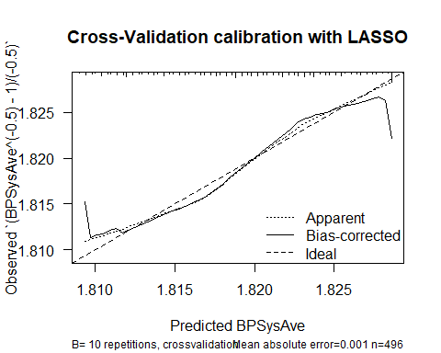

Slide 20
## ## n=496 Mean absolute error=0.001 Mean squared error=0 ## 0.9 Quantile of absolute error=0.001
#dev.off() test_minus_id.lasso.tranformation <- test_minus_id[-lasso.outliers,] test_minus_id.lasso.tranformation$`(BPSysAve^(-0.5) - 1)/(-0.5)` <- (test_minus_id.lasso.tranformation$BPSysAve^.5 - 1)/ .5 ## Test Error ## pred.lasso <- predict(ols.lasso, newdata = test_minus_id.lasso.tranformation) ## Prediction error ## pred.error.lasso <- mean((test_minus_id.lasso.tranformation$`(BPSysAve^(-0.5) - 1)/(-0.5)` - pred.lasso)^2)
aic model
variable selection
model.lm <- lm (BPSysAve~ ., data = train_minus_id) summary(model.lm)
## ## Call: ## lm(formula = BPSysAve ~ ., data = train_minus_id) ## ## Residuals: ## Min 1Q Median 3Q Max ## -44.816 -9.668 -0.754 9.019 61.150 ## ## Coefficients: ## Estimate Std. Error t value Pr(>|t|) ## (Intercept) 175.32295 58.07097 3.019 0.00268 ** ## Gendermale 3.24539 2.01738 1.609 0.10836 ## Age 0.53500 0.05474 9.773 < 2e-16 *** ## Race3Black 7.78296 4.18558 1.859 0.06360 . ## Race3Hispanic 4.84084 4.64456 1.042 0.29784 ## Race3Mexican 4.39209 4.66721 0.941 0.34717 ## Race3White 2.25183 3.74627 0.601 0.54808 ## Race3Other -3.16617 5.39096 -0.587 0.55728 ## Education9 - 11th Grade -1.52333 3.28156 -0.464 0.64272 ## EducationHigh School -0.28400 3.07475 -0.092 0.92645 ## EducationSome College 0.93238 3.06363 0.304 0.76101 ## EducationCollege Grad -1.97907 3.36150 -0.589 0.55632 ## MaritalStatusLivePartner -1.42350 2.99910 -0.475 0.63527 ## MaritalStatusMarried -3.78705 2.26820 -1.670 0.09567 . ## MaritalStatusNeverMarried 3.10287 2.77621 1.118 0.26429 ## MaritalStatusSeparated -6.81544 5.04845 -1.350 0.17767 ## MaritalStatusWidowed 1.12319 3.28249 0.342 0.73237 ## HHIncome 5000-9999 -6.62464 6.28070 -1.055 0.29209 ## HHIncome10000-14999 -3.94524 5.33768 -0.739 0.46020 ## HHIncome15000-19999 -10.43443 5.36976 -1.943 0.05260 . ## HHIncome20000-24999 -6.02142 5.37616 -1.120 0.26329 ## HHIncome25000-34999 -7.32342 5.28099 -1.387 0.16619 ## HHIncome35000-44999 -8.41409 5.49167 -1.532 0.12617 ## HHIncome45000-54999 -9.09756 5.81827 -1.564 0.11859 ## HHIncome55000-64999 -7.49498 6.41055 -1.169 0.24294 ## HHIncome65000-74999 -3.10158 6.35765 -0.488 0.62589 ## HHIncome75000-99999 0.84807 6.32161 0.134 0.89334 ## HHIncomemore 99999 0.13591 6.26647 0.022 0.98271 ## Poverty -2.17460 0.92469 -2.352 0.01911 * ## Weight 0.37465 0.33504 1.118 0.26406 ## Height -0.42714 0.34297 -1.245 0.21362 ## BMI -0.98037 0.96845 -1.012 0.31192 ## DepressedSeveral -0.42129 1.82545 -0.231 0.81758 ## DepressedMost 2.15839 2.61450 0.826 0.40949 ## SleepHrsNight 0.03708 0.52440 0.071 0.94367 ## SleepTroubleYes -2.67353 1.54819 -1.727 0.08486 . ## PhysActiveYes -0.62633 1.55355 -0.403 0.68702 ## SmokeNowYes -0.67578 1.56942 -0.431 0.66696 ## --- ## Signif. codes: 0 '***' 0.001 '**' 0.01 '*' 0.05 '.' 0.1 ' ' 1 ## ## Residual standard error: 15 on 462 degrees of freedom ## Multiple R-squared: 0.3123, Adjusted R-squared: 0.2572 ## F-statistic: 5.67 on 37 and 462 DF, p-value: < 2.2e-16
n <- nrow(train_minus_id) sel.var.aic <- step(model.lm, trace = 0, k = 2, direction = "both") sel.var.aic<-attr(terms(sel.var.aic), "term.labels") sel.var.aic
## [1] "Gender" "Age" "Race3" "MaritalStatus" ## [5] "HHIncome" "Poverty" "SleepTrouble"
model.aic <- lm(BPSysAve ~., data = train_minus_id[,c(sel.var.aic, "BPSysAve")])
diagnostics
r.aic <- f_multi_diagnostic(model.aic)
## [1] "leverage" ## 420 675 311 206 262 190 677 583 94 531 436 594 696 552 290 403 630 275 725 102 ## 9 16 34 39 50 53 60 68 73 166 180 246 275 282 291 297 298 355 365 390 ## 522 351 619 54 135 179 474 ## 393 396 401 447 466 473 488 ## [1] "cut_d" ## named integer(0) ## [1] "cut_fits" ## 310 420 196 631 86 107 311 319 206 90 20 362 142 348 260 343 677 443 231 583 ## 2 9 11 12 18 23 34 38 39 41 42 44 48 49 51 56 60 66 67 68 ## 246 94 167 704 424 488 428 545 126 665 617 36 209 487 225 476 279 564 516 95 ## 72 73 77 78 80 85 89 95 96 97 98 99 101 102 106 109 117 120 122 125 ## 604 106 104 171 641 674 177 111 720 131 245 646 363 526 413 599 436 471 47 154 ## 129 131 138 140 143 152 154 155 156 157 164 167 169 175 177 178 180 184 186 187 ## 625 23 383 695 731 15 426 283 276 423 687 418 108 315 457 594 557 606 338 512 ## 192 193 194 201 204 205 208 210 211 212 217 233 235 236 240 246 250 257 260 265 ## 251 43 552 403 630 632 324 723 492 530 300 671 125 72 214 541 373 610 239 243 ## 267 281 282 297 298 315 328 333 337 347 349 356 357 364 372 375 376 384 386 387 ## 522 619 571 511 647 79 314 129 432 226 78 513 76 444 54 603 303 281 664 135 ## 393 401 408 409 410 415 422 433 436 439 441 442 443 444 447 449 452 457 462 466 ## 336 274 375 650 694 474 37 626 ## 476 477 482 483 486 488 491 500 ## [1] "cut_beta" ## 691 420 675 348 262 167 476 268 171 177 471 283 338 696 632 492 72 243 522 314 ## 3 9 16 49 50 77 109 110 140 154 184 210 260 275 315 337 364 387 393 422 ## 513 54 ## 442 447 ## [1] "lev + cut_b" ## [1] 9 16 50 275 393 447 ## [1] "lev + cut_fits" ## [1] 9 34 39 60 68 73 180 246 282 297 298 393 401 447 466 488 ## [1] " lev + cut_d" ## integer(0) ## [1] "b + fits" ## [1] 9 49 77 109 140 154 184 210 260 315 337 364 387 393 422 442 447 ## [1] "d + b" ## integer(0) ## [1] "d + fits" ## integer(0) ## [1] " all outliers intersect" ## integer(0)

Slide 21
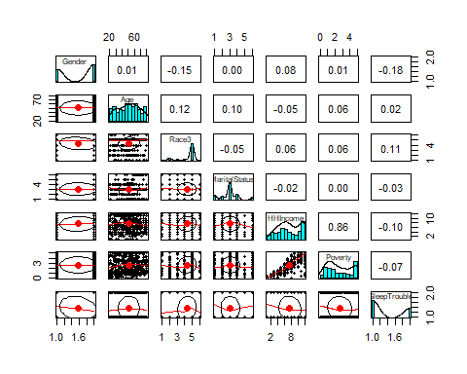

Slide 22
## NULL

Slide 23
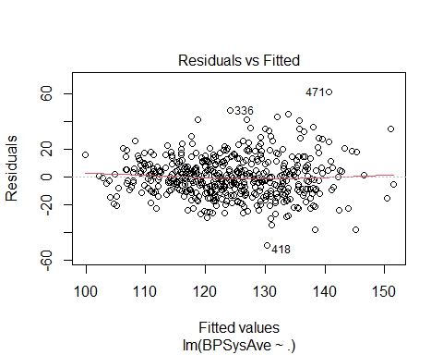

Slide 24
## NULL ## Analysis of Variance Table ## ## Response: BPSysAve ## Df Sum Sq Mean Sq F value Pr(>F) ## Gender 1 1348 1347.9 6.0629 0.0141599 * ## Age 1 30323 30323.1 136.3984 < 2.2e-16 *** ## Race3 5 2125 425.0 1.9115 0.0909606 . ## MaritalStatus 5 4881 976.2 4.3913 0.0006428 *** ## HHIncome 11 4768 433.5 1.9497 0.0316128 * ## Poverty 1 1639 1638.8 7.3716 0.0068681 ** ## SleepTrouble 1 632 631.9 2.8425 0.0924571 . ## Residuals 474 105376 222.3 ## --- ## Signif. codes: 0 '***' 0.001 '**' 0.01 '*' 0.05 '.' 0.1 ' ' 1 ## [1] "VIF" ## GVIF Df GVIF^(1/(2*Df)) ## Gender 1.160952 1 1.077475 ## Age 1.527480 1 1.235913 ## Race3 1.336965 5 1.029466 ## MaritalStatus 2.007030 5 1.072150 ## HHIncome 6.383621 11 1.087912 ## Poverty 4.458362 1 2.111483 ## SleepTrouble 1.096534 1 1.047155
model.aic.vif.outliers.df <- model.aic$model[-union(union(r.aic[[1]], r.aic[[2]]), r.aic[[4]]), -which(names( model.aic$model) == "HHIncome")] model.aic.vif.outliers <- lm(BPSysAve ~., data = model.aic.vif.outliers.df) mult <- lm(cbind(BPSysAve, Age, Poverty)~1, data = model.aic.vif.outliers.df %>% filter(Poverty > 0)) # this allows us to ensure that we can do the boxcox tranformation function, only a few observations, so unlikely to lead to a large problem summary(powerTransform(mult))
## bcPower Transformations to Multinormality ## Est Power Rounded Pwr Wald Lwr Bnd Wald Upr Bnd ## BPSysAve -0.1837 0.0 -0.7101 0.3426 ## Age 0.8826 1.0 0.6287 1.1366 ## Poverty 0.5171 0.5 0.3920 0.6422 ## ## Likelihood ratio test that transformation parameters are equal to 0 ## (all log transformations) ## LRT df pval ## LR test, lambda = (0 0 0) 140.2223 3 < 2.22e-16 ## ## Likelihood ratio test that no transformations are needed ## LRT df pval ## LR test, lambda = (1 1 1) 66.84866 3 2.0206e-14
boxcox
model.aic.vif.outliers.boxcox <- lm(log(BPSysAve) ~ Gender + Race3 + MaritalStatus + Age + I((Poverty^.5 - 1)/.5) + SleepTrouble ,data = model.aic.vif.outliers.df) #model.aic.vif.outliers.boxcox$model$`I(geometric.mean(Poverty)^(1 - 0.5) * (Poverty^0.5 - 1)/0.5)` f_multi_minus_vif(model.aic.vif.outliers.boxcox)
## [1] "leverage" ## 310 691 190 268 30 641 531 66 84 82 457 702 557 398 290 501 275 194 502 102 ## 2 3 47 99 117 131 153 192 206 208 224 228 233 237 271 330 331 345 360 364 ## 409 692 414 511 444 664 179 37 302 298 ## 367 378 379 381 414 431 441 458 461 466 ## [1] "cut_d" ## named integer(0) ## [1] "cut_fits" ## 196 631 107 319 20 362 260 343 443 231 424 488 545 126 665 617 209 225 268 279 ## 10 11 21 35 38 40 45 50 59 60 70 75 85 86 87 88 91 96 99 106 ## 564 104 641 674 111 245 531 646 413 599 47 154 625 695 15 687 84 418 108 315 ## 109 127 131 140 142 151 153 154 164 165 171 172 177 186 190 201 206 217 219 220 ## 457 557 606 523 251 199 43 723 300 501 275 671 125 610 239 409 414 571 511 79 ## 224 233 240 244 249 252 262 310 325 330 331 332 333 359 361 367 379 380 381 387 ## 444 303 281 664 336 375 694 37 ## 414 421 426 431 444 450 454 458 ## [1] "cut_beta" ## 310 704 268 564 84 418 290 692 414 571 444 302 ## 2 68 99 109 206 217 271 378 379 380 414 461 ## [1] "lev + cut_b" ## [1] 2 99 206 271 378 379 414 461 ## [1] "lev + cut_fits" ## [1] 99 131 153 206 224 233 330 331 367 379 381 414 431 458 ## [1] " lev + cut_d" ## integer(0) ## [1] "b + fits" ## [1] 99 109 206 217 379 380 414 ## [1] "d + b" ## integer(0) ## [1] "d + fits" ## integer(0) ## [1] " all outliers intersect" ## integer(0)

Slide 25
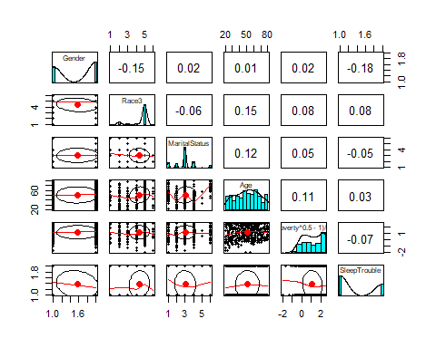

Slide 26
## NULL

Slide 27
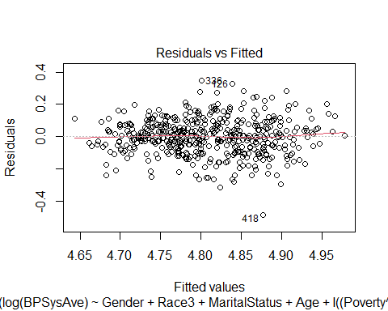

Slide 28
## NULL ## Analysis of Variance Table ## ## Response: log(BPSysAve) ## Df Sum Sq Mean Sq F value Pr(>F) ## Gender 1 0.0679 0.06791 5.3362 0.02134 * ## Race3 5 0.0962 0.01924 1.5122 0.18455 ## MaritalStatus 5 0.5338 0.10676 8.3887 1.335e-07 *** ## Age 1 1.3769 1.37686 108.1882 < 2.2e-16 *** ## I((Poverty^0.5 - 1)/0.5) 1 0.0396 0.03956 3.1086 0.07855 . ## SleepTrouble 1 0.0168 0.01685 1.3239 0.25051 ## Residuals 452 5.7524 0.01273 ## --- ## Signif. codes: 0 '***' 0.001 '**' 0.01 '*' 0.05 '.' 0.1 ' ' 1
## [[1]] ## [1] 2 99 206 271 378 379 414 461 ## ## [[2]] ## [1] 99 131 153 206 224 233 330 331 367 379 381 414 431 458 ## ## [[3]] ## integer(0) ## ## [[4]] ## [1] 99 109 206 217 379 380 414 ## ## [[5]] ## integer(0) ## ## [[6]] ## integer(0) ## ## [[7]] ## integer(0)
model.aic.vif.outliers
## ## Call: ## lm(formula = BPSysAve ~ ., data = model.aic.vif.outliers.df) ## ## Coefficients: ## (Intercept) Gendermale ## 93.2780 1.8123 ## Age Race3Black ## 0.4957 11.4762 ## Race3Hispanic Race3Mexican ## 9.6355 8.0931 ## Race3White Race3Other ## 5.9953 3.6812 ## MaritalStatusLivePartner MaritalStatusMarried ## 0.3960 -2.3712 ## MaritalStatusNeverMarried MaritalStatusSeparated ## 4.7795 -10.5305 ## MaritalStatusWidowed Poverty ## 3.2403 -0.7665 ## SleepTroubleYes ## -1.5409
error.aic <- mean((model.aic.vif.outliers.boxcox$fitted.values - model.aic.vif.outliers.boxcox$model$`log(BPSysAve)`)^2) error.aic
## [1] 0.01231778
cross validation and testing
ols.aic <- ols(`log(BPSysAve)` ~ ., data = model.aic.vif.outliers.boxcox$model, x=T, y=T, model = T) ## 10 fold cross validation ## aic.cross <- calibrate(ols.aic, method = "crossvalidation", B = 10) ## Calibration plot ## plot(aic.cross, las = 1, xlab = "Predicted BPSysAve", main = "Cross-Validation calibration with AIC")

Slide 29
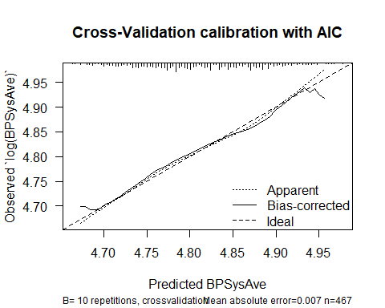

Slide 30
## ## n=467 Mean absolute error=0.007 Mean squared error=7e-05 ## 0.9 Quantile of absolute error=0.013
g <- test_minus_id$BPSysAve gsub(",", "", g)
## [1] "103" "110" "122" "121" "123" "125" "130" "141" "217" "128" "108" "107" ## [13] "131" "143" "86" "126" "124" "132" "133" "115" "102" "138" "137" "166" ## [25] "119" "119" "122" "157" "124" "116" "105" "132" "122" "165" "154" "128" ## [37] "121" "115" "99" "121" "126" "114" "117" "117" "104" "101" "119" "97" ## [49] "170" "115" "120" "122" "140" "136" "116" "121" "110" "108" "118" "143" ## [61] "130" "107" "128" "127" "156" "135" "102" "128" "130" "133" "124" "109" ## [73] "98" "109" "115" "125" "125" "136" "137" "100" "140" "132" "137" "114" ## [85] "138" "122" "117" "105" "118" "113" "119" "128" "141" "130" "123" "116" ## [97] "152" "110" "124" "116" "191" "114" "114" "161" "118" "124" "153" "129" ## [109] "116" "128" "145" "130" "98" "113" "112" "106" "123" "117" "188" "142" ## [121] "116" "116" "124" "95" "123" "134" "129" "112" "160" "136" "122" "124" ## [133] "126" "133" "114" "152" "105" "116" "169" "102" "98" "135" "140" "116" ## [145] "104" "119" "122" "179" "122" "110" "131" "149" "110" "133" "112" "112" ## [157] "127" "123" "123" "117" "124" "121" "118" "141" "126" "103" "128" "114" ## [169] "123" "123" "104" "112" "150" "141" "132" "120" "131" "119" "100" "153" ## [181] "145" "111" "138" "107" "118" "114" "112" "105" "133" "112" "114" "111" ## [193] "121" "118" "128" "132" "118" "113" "129" "114" "113" "119" "130" "133" ## [205] "143" "126" "107" "108" "114" "129" "112" "114" "123" "161" "105" "103" ## [217] "117" "110" "173" "112" "99" "105" "133" "121" "127" "179" "121" "147" ## [229] "109" "103" "147" "165" "131" "113" "159" "147" "136" "118" "114" "107" ## [241] "142" "137" "112"
g2 <-gsub(",", "", g) test_minus_id.aic.transformation <- test_minus_id[-union(union(r.aic[[1]], r.aic[[2]]), r.aic[[4]]),] g <- test_minus_id.aic.transformation$BPSysAve gsub(",", "", g)
## [1] "103" "110" "122" "121" "123" "125" "130" "141" "128" "108" "107" "131" ## [13] "143" "86" "124" "132" "133" "115" "102" "138" "137" "166" "119" "119" ## [25] "122" "157" "124" "116" "105" "132" "122" "154" "128" "121" "115" "121" ## [37] "126" "114" "117" "117" "104" "101" "119" "97" "120" "122" "140" "136" ## [49] "116" "121" "110" "108" "118" "130" "107" "128" "127" "156" "135" "102" ## [61] "130" "133" "124" "109" "109" "115" "125" "136" "137" "100" "140" "132" ## [73] "137" "114" "138" "122" "117" "105" "118" "113" "119" "128" "141" "130" ## [85] "123" "116" "152" "110" "124" "116" "191" "114" "114" "161" "118" "124" ## [97] "153" "129" "128" "145" "130" "98" "113" "112" "106" "123" "117" "188" ## [109] "142" "116" "116" "124" "95" "123" "134" "129" "112" "160" "136" "122" ## [121] "124" "126" "133" "114" "152" "105" "116" "169" "98" "135" "140" "116" ## [133] "104" "119" "122" "179" "122" "110" "131" "149" "110" "112" "112" "127" ## [145] "123" "123" "117" "124" "121" "118" "141" "126" "103" "128" "114" "123" ## [157] "123" "104" "112" "150" "141" "132" "120" "131" "119" "100" "145" "111" ## [169] "138" "118" "114" "112" "105" "133" "112" "114" "111" "121" "118" "128" ## [181] "132" "118" "113" "129" "114" "113" "119" "130" "133" "143" "126" "107" ## [193] "108" "114" "112" "114" "123" "161" "105" "103" "117" "110" "173" "112" ## [205] "99" "105" "133" "121" "127" "179" "121" "147" "109" "103" "147" "165" ## [217] "131" "113" "159" "147" "136" "118" "114" "107" "142" "137" "112"
g2 <-gsub(",", "", g) test_minus_id.aic.transformation$`log(BPSysAve)` <- log(as.numeric(g2)) test_minus_id.aic.transformation$`I((Poverty^0.5 - 1)/0.5)` <- I((test_minus_id.aic.transformation$Poverty^.5 - 1)/.5) ## Test Error ## pred.aic <- predict(ols.aic, newdata = test_minus_id.aic.transformation[,c( "Gender", "Age" , "Race3" , "MaritalStatus", "I((Poverty^0.5 - 1)/0.5)", "SleepTrouble", "log(BPSysAve)")]) ## Prediction error ## pred.error.AIC <- mean((test_minus_id.aic.transformation$`log(BPSysAve)` - pred.aic)^2) pred.error.AIC
## [1] 0.01540345
BIC
n <- nrow(train) sel.var.bic <- step(model.lm, trace = 0, k = log(n), direction = "both") sel.var.bic<-attr(terms(sel.var.bic), "term.labels") sel.var.bic
## [1] "Age" "Poverty"
model.bic<- lm(BPSysAve ~., data = train_minus_id[,c(sel.var.bic, "BPSysAve")])
###diagnostics
r.bic <- f_multi_diagnostic(model.bic)
## [1] "leverage" ## 206 357 102 351 ## 39 316 390 396 ## [1] "cut_d" ## named integer(0) ## [1] "cut_fits" ## 196 348 231 167 573 126 209 564 95 471 193 687 418 108 315 251 723 300 610 522 ## 11 49 67 77 92 96 101 120 125 184 185 217 233 235 236 267 333 349 384 393 ## 571 513 444 664 336 ## 408 442 444 462 476 ## [1] "cut_beta" ## 196 631 682 260 343 231 167 573 126 104 413 193 154 687 315 594 606 523 241 579 ## 11 12 47 51 56 67 77 92 96 138 177 185 187 217 236 246 257 262 283 325 ## 723 610 448 351 571 432 226 513 135 336 ## 333 384 389 396 408 436 439 442 466 476 ## [1] "lev + cut_b" ## [1] 396 ## [1] "lev + cut_fits" ## integer(0) ## [1] " lev + cut_d" ## integer(0) ## [1] "b + fits" ## [1] 11 67 77 92 96 185 217 236 333 384 408 442 476 ## [1] "d + b" ## integer(0) ## [1] "d + fits" ## integer(0) ## [1] " all outliers intersect" ## integer(0)

Slide 31
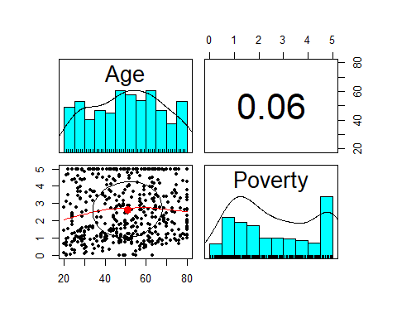

Slide 32
## NULL

Slide 33
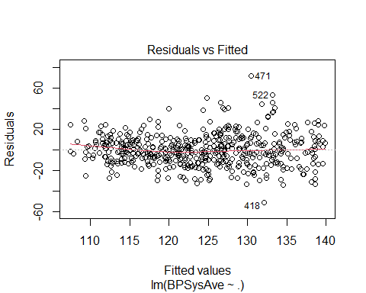

Slide 34
## NULL ## Analysis of Variance Table ## ## Response: BPSysAve ## Df Sum Sq Mean Sq F value Pr(>F) ## Age 1 30507 30507.0 128.1465 < 2.2e-16 *** ## Poverty 1 2268 2267.7 9.5255 0.002139 ** ## Residuals 497 118317 238.1 ## --- ## Signif. codes: 0 '***' 0.001 '**' 0.01 '*' 0.05 '.' 0.1 ' ' 1 ## [1] "VIF" ## Age Poverty ## 1.004177 1.004177
outliers
model.bic.vif.outliers.df <- model.bic$model[-union(r.bic[[1]], r.bic[[4]]),] model.bic.vif.outliers <- lm(BPSysAve ~., data = model.bic.vif.outliers.df)
#boxcox
mult <- lm(cbind(BPSysAve, Age, Poverty)~1, data = model.bic.vif.outliers.df %>% filter(Poverty > 0)) summary(powerTransform(mult))
## bcPower Transformations to Multinormality ## Est Power Rounded Pwr Wald Lwr Bnd Wald Upr Bnd ## BPSysAve -0.1050 0.0 -0.6004 0.3904 ## Age 0.8617 1.0 0.6093 1.1142 ## Poverty 0.5140 0.5 0.4013 0.6266 ## ## Likelihood ratio test that transformation parameters are equal to 0 ## (all log transformations) ## LRT df pval ## LR test, lambda = (0 0 0) 160.6255 3 < 2.22e-16 ## ## Likelihood ratio test that no transformations are needed ## LRT df pval ## LR test, lambda = (1 1 1) 77.36574 3 < 2.22e-16
model.bic.vif.outliers.boxcox <- lm(log(BPSysAve) ~ #Gender + #Race3 + #MaritalStatus + Age + I((Poverty^.5 - 1)/.5) #SleepTrouble ,data = model.bic.vif.outliers.df) f_multi_diagnostic(model.bic.vif.outliers.boxcox)
## [1] "leverage" ## 420 675 206 262 435 232 177 667 696 357 510 725 102 522 179 ## 9 15 38 49 88 116 149 248 267 308 321 356 380 383 460 ## [1] "cut_d" ## named integer(0) ## [1] "cut_fits" ## 107 319 348 361 209 564 95 104 171 413 471 154 418 594 338 251 300 448 522 592 ## 22 37 48 83 96 115 120 133 135 172 179 181 226 238 252 259 340 379 383 385 ## 226 444 ## 427 431 ## [1] "cut_beta" ## 631 86 20 682 260 343 218 488 361 353 104 413 154 594 606 338 523 241 121 579 ## 11 17 41 46 50 55 64 82 83 113 133 172 181 238 249 252 254 275 297 317 ## 448 432 226 444 135 ## 379 424 427 431 453 ## [1] "lev + cut_b" ## integer(0) ## [1] "lev + cut_fits" ## [1] 383 ## [1] " lev + cut_d" ## integer(0) ## [1] "b + fits" ## [1] 83 133 172 181 238 252 379 427 431 ## [1] "d + b" ## integer(0) ## [1] "d + fits" ## integer(0) ## [1] " all outliers intersect" ## integer(0)

Slide 35
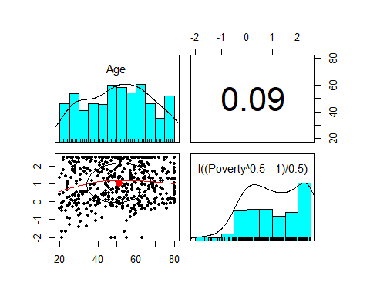

Slide 36
## NULL

Slide 37
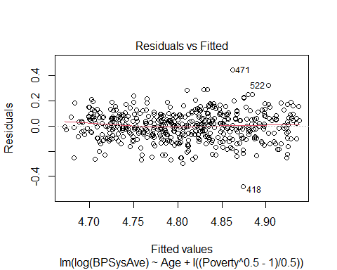

Slide 38
## NULL ## Analysis of Variance Table ## ## Response: log(BPSysAve) ## Df Sum Sq Mean Sq F value Pr(>F) ## Age 1 1.9841 1.98407 152.719 < 2.2e-16 *** ## I((Poverty^0.5 - 1)/0.5) 1 0.1474 0.14737 11.344 0.0008175 *** ## Residuals 483 6.2750 0.01299 ## --- ## Signif. codes: 0 '***' 0.001 '**' 0.01 '*' 0.05 '.' 0.1 ' ' 1 ## [1] "VIF" ## Age I((Poverty^0.5 - 1)/0.5) ## 1.007638 1.007638
## [[1]] ## integer(0) ## ## [[2]] ## [1] 383 ## ## [[3]] ## integer(0) ## ## [[4]] ## [1] 83 133 172 181 238 252 379 427 431 ## ## [[5]] ## integer(0) ## ## [[6]] ## integer(0) ## ## [[7]] ## integer(0)
error.bic <- mean((model.bic.vif.outliers.boxcox$fitted.values - model.bic.vif.outliers.boxcox$model$`log(BPSysAve)`)^2) error.bic
## [1] 0.01291148
testing and cross validation
ols.bic <- ols(`log(BPSysAve)` ~ ., data = model.bic.vif.outliers.boxcox$model, x=T, y=T, model = T) ## 10 fold cross validation ## bic.cross <- calibrate(ols.bic, method = "crossvalidation", B = 10) #bic.boot <- calibrate(ols.bic, method = "boot", B = 10) ## Calibration plot ## #pdf("bic_cross.pdf", height = 8, width = 16) plot(bic.cross, las = 1, xlab = "Predicted BPSysAve", main = "Cross-Validation calibration with BIC")

Slide 39
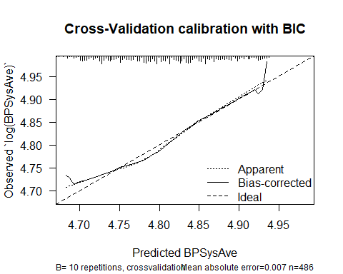

Slide 40
## ## n=486 Mean absolute error=0.007 Mean squared error=1e-04 ## 0.9 Quantile of absolute error=0.014
#plot(bic.boot,las = 1, xlab = "Predicted LPSA", main = "Bootstrapping calibration with BIC") #dev.off() test_minus_id.bic.transformation <- test_minus_id[-union(r.bic[[1]],r.bic[[4]]),] g <- test_minus_id.bic.transformation$BPSysAve #gsub(",", "", g) g2 <-gsub(",", "", g) test_minus_id.bic.transformation$`log(BPSysAve)` <- log(as.numeric(g2)) test_minus_id.bic.transformation$`I((Poverty^0.5 - 1)/0.5)` <- I((test_minus_id.bic.transformation$Poverty^0.5 - 1)/0.5) ## Test Error ## pred.bic <- predict(ols.bic, newdata = test_minus_id.bic.transformation[,c("Age","I((Poverty^0.5 - 1)/0.5)", "log(BPSysAve)")]) ## Prediction error ## pred.error.BIC <- mean((test_minus_id.bic.transformation$`log(BPSysAve)` - pred.bic)^2) pred.error.BIC
## [1] 0.01713172

Slide 41
model choice
print(c(pred.error.AIC, pred.error.BIC, pred.error.lasso, min(c(pred.error.AIC, pred.error.BIC, pred.error.lasso))))
## [1] 0.01540345 0.01713172 344.23522691 0.01540345

Slide 42
adding in smokenow to BIc mdel
model.bic.vif.outliers.boxcox.smokeNow <- lm(`log(BPSysAve)` ~., data = cbind(model.bic.vif.outliers.boxcox$model, train_minus_id[-union(r.bic[[1]],r.bic[[4]]),]$SmokeNow))
diagnostic of BIC with smoek now
model.bic.vif.outliers.boxcox.smokeNow %>% f_multi_diagnostic()
## [1] "leverage" ## 675 206 262 435 232 607 667 696 102 522 179 ## 15 38 49 88 116 196 248 267 380 383 460 ## [1] "cut_d" ## named integer(0) ## [1] "cut_fits" ## 107 348 361 209 564 104 471 154 15 426 418 594 251 300 239 243 522 226 444 213 ## 22 48 83 96 115 133 179 181 199 202 226 238 259 340 376 377 383 427 431 448 ## 474 ## 474 ## [1] "cut_beta" ## 107 260 443 361 104 646 413 154 607 15 426 418 594 743 523 251 59 630 239 522 ## 22 50 65 83 133 162 172 181 196 199 202 226 238 251 254 259 271 290 376 383 ## 297 226 303 213 664 474 ## 425 427 439 448 449 474 ## [1] "lev + cut_b" ## [1] 196 383 ## [1] "lev + cut_fits" ## [1] 383 ## [1] " lev + cut_d" ## integer(0) ## [1] "b + fits" ## [1] 22 83 133 181 199 202 226 238 259 376 383 427 448 474 ## [1] "d + b" ## integer(0) ## [1] "d + fits" ## integer(0) ## [1] " all outliers intersect" ## integer(0)

Slide 43
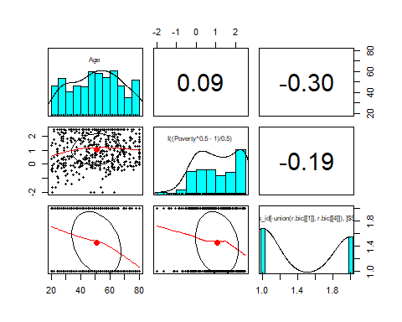

Slide 44
## NULL

Slide 45
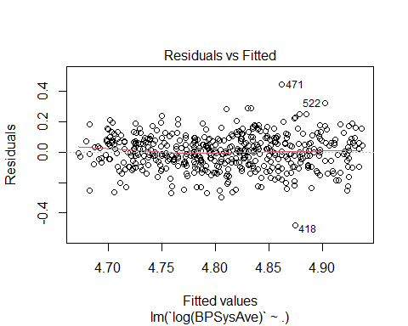

Slide 46
## NULL ## Analysis of Variance Table ## ## Response: log(BPSysAve) ## Df Sum Sq Mean Sq ## Age 1 1.9841 1.98407 ## `I((Poverty^0.5 - 1)/0.5)` 1 0.1474 0.14737 ## `train_minus_id[-union(r.bic[[1]], r.bic[[4]]), ]$SmokeNow` 1 0.0001 0.00005 ## Residuals 482 6.2749 0.01302 ## F value Pr(>F) ## Age 152.4037 < 2.2e-16 ## `I((Poverty^0.5 - 1)/0.5)` 11.3203 0.0008278 ## `train_minus_id[-union(r.bic[[1]], r.bic[[4]]), ]$SmokeNow` 0.0039 0.9501031 ## Residuals ## ## Age *** ## `I((Poverty^0.5 - 1)/0.5)` *** ## `train_minus_id[-union(r.bic[[1]], r.bic[[4]]), ]$SmokeNow` ## Residuals ## --- ## Signif. codes: 0 '***' 0.001 '**' 0.01 '*' 0.05 '.' 0.1 ' ' 1 ## [1] "VIF" ## Age ## 1.099263 ## `I((Poverty^0.5 - 1)/0.5)` ## 1.036887 ## `train_minus_id[-union(r.bic[[1]], r.bic[[4]]), ]$SmokeNow` ## 1.129889
## [[1]] ## [1] 196 383 ## ## [[2]] ## [1] 383 ## ## [[3]] ## integer(0) ## ## [[4]] ## [1] 22 83 133 181 199 202 226 238 259 376 383 427 448 474 ## ## [[5]] ## integer(0) ## ## [[6]] ## integer(0) ## ## [[7]] ## integer(0)
summary(model.bic.vif.outliers.boxcox.smokeNow)
## ## Call: ## lm(formula = `log(BPSysAve)` ~ ., data = cbind(model.bic.vif.outliers.boxcox$model, ## train_minus_id[-union(r.bic[[1]], r.bic[[4]]), ]$SmokeNow)) ## ## Residuals: ## Min 1Q Median 3Q Max ## -0.48010 -0.07132 0.00198 0.07570 0.44595 ## ## Coefficients: ## Estimate ## (Intercept) 4.6246833 ## Age 0.0039046 ## `I((Poverty^0.5 - 1)/0.5)` -0.0159351 ## `train_minus_id[-union(r.bic[[1]], r.bic[[4]]), ]$SmokeNow`Yes 0.0006923 ## Std. Error ## (Intercept) 0.0199582 ## Age 0.0003234 ## `I((Poverty^0.5 - 1)/0.5)` 0.0048197 ## `train_minus_id[-union(r.bic[[1]], r.bic[[4]]), ]$SmokeNow`Yes 0.0110570 ## t value Pr(>|t|) ## (Intercept) 231.718 < 2e-16 ## Age 12.073 < 2e-16 ## `I((Poverty^0.5 - 1)/0.5)` -3.306 0.00102 ## `train_minus_id[-union(r.bic[[1]], r.bic[[4]]), ]$SmokeNow`Yes 0.063 0.95010 ## ## (Intercept) *** ## Age *** ## `I((Poverty^0.5 - 1)/0.5)` ** ## `train_minus_id[-union(r.bic[[1]], r.bic[[4]]), ]$SmokeNow`Yes ## --- ## Signif. codes: 0 '***' 0.001 '**' 0.01 '*' 0.05 '.' 0.1 ' ' 1 ## ## Residual standard error: 0.1141 on 482 degrees of freedom ## Multiple R-squared: 0.2536, Adjusted R-squared: 0.2489 ## F-statistic: 54.58 on 3 and 482 DF, p-value: < 2.2e-16
anova(model.bic.vif.outliers.boxcox.smokeNow)
## Analysis of Variance Table ## ## Response: log(BPSysAve) ## Df Sum Sq Mean Sq ## Age 1 1.9841 1.98407 ## `I((Poverty^0.5 - 1)/0.5)` 1 0.1474 0.14737 ## `train_minus_id[-union(r.bic[[1]], r.bic[[4]]), ]$SmokeNow` 1 0.0001 0.00005 ## Residuals 482 6.2749 0.01302 ## F value Pr(>F) ## Age 152.4037 < 2.2e-16 ## `I((Poverty^0.5 - 1)/0.5)` 11.3203 0.0008278 ## `train_minus_id[-union(r.bic[[1]], r.bic[[4]]), ]$SmokeNow` 0.0039 0.9501031 ## Residuals ## ## Age *** ## `I((Poverty^0.5 - 1)/0.5)` *** ## `train_minus_id[-union(r.bic[[1]], r.bic[[4]]), ]$SmokeNow` ## Residuals ## --- ## Signif. codes: 0 '***' 0.001 '**' 0.01 '*' 0.05 '.' 0.1 ' ' 1
calibration and training
ols.bic.smokenow <- ols(`log(BPSysAve)` ~ ., data = as.data.frame(data.matrix(model.bic.vif.outliers.boxcox.smokeNow$model)), x=T, y=T, model = T) ## 10 fold cross validation ## bic.cross.smoke.now <- calibrate(ols.bic.smokenow, method = "crossvalidation", B = 10) #bic.boot <- calibrate(ols.bic, method = "boot", B = 10) ## Calibration plot ## #pdf("bic_cross.pdf", height = 8, width = 16) plot(bic.cross, las = 1, xlab = "Predicted BPSysAve", main = "Cross-Validation calibration for smokenow with BIC")

Slide 47
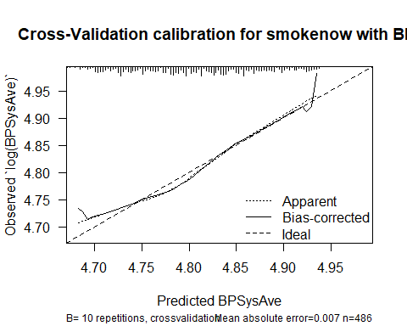

Slide 48
## ## n=486 Mean absolute error=0.007 Mean squared error=1e-04 ## 0.9 Quantile of absolute error=0.014
#plot(bic.boot,las = 1, xlab = "Predicted LPSA", main = "Bootstrapping calibration with BIC") #dev.off() test_minus_id.bic.transformation.smokenow <- test_minus_id[-union(r.bic[[1]],r.bic[[4]]),] g <- test_minus_id.bic.transformation.smokenow$BPSysAve #gsub(",", "", g) g2 <-gsub(",", "", g) test_minus_id.bic.transformation.smokenow$`log(BPSysAve)` <- log(as.numeric(g2)) test_minus_id.bic.transformation.smokenow$`I((Poverty^0.5 - 1)/0.5)` <- I((test_minus_id.bic.transformation.smokenow$Poverty^0.5 - 1)/0.5) `train_minus_id[-union(r.bic[[1]], r.bic[[4]]), ]$SmokeNow` <- test_minus_id[-union(r.bic[[1]],r.bic[[4]]),]$SmokeNow ## Test Error ## train_minus_id <- train_minus_id %>% mutate('train_minus_id[-union(r.bic[[1]], r.bic[[4]]), ]$SmokeNow' = SmokeNow) pred.bic.smokenow <- predict(ols.bic.smokenow, newdata = test_minus_id.bic.transformation.smokenow[,c(2 , 18, 17, 16 #"Age", # "I((Poverty^0.5 - 1)/0.5)", #"log(BPSysAve)", #"train_minus_id[-union(r.bic[[1]],r.bic[[4]]),]$SmokeNow" )]) ## Prediction error ##
prediction error
pred.error.BIC.smokenow <- mean((test_minus_id.bic.transformation.smokenow$`log(BPSysAve)` - pred.bic.smokenow)^2) pred.error.BIC.smokenow
## [1] 0.01715312

